Slide 1
PERSPECTIVES ON THE BOSTON MASSACRE: IMAGES of March 5th, 1770

Slide 2
Complete this organizer for each of the following images
What details do I notice?
What inferences can I make about the perspective of the artist?

Slide 3
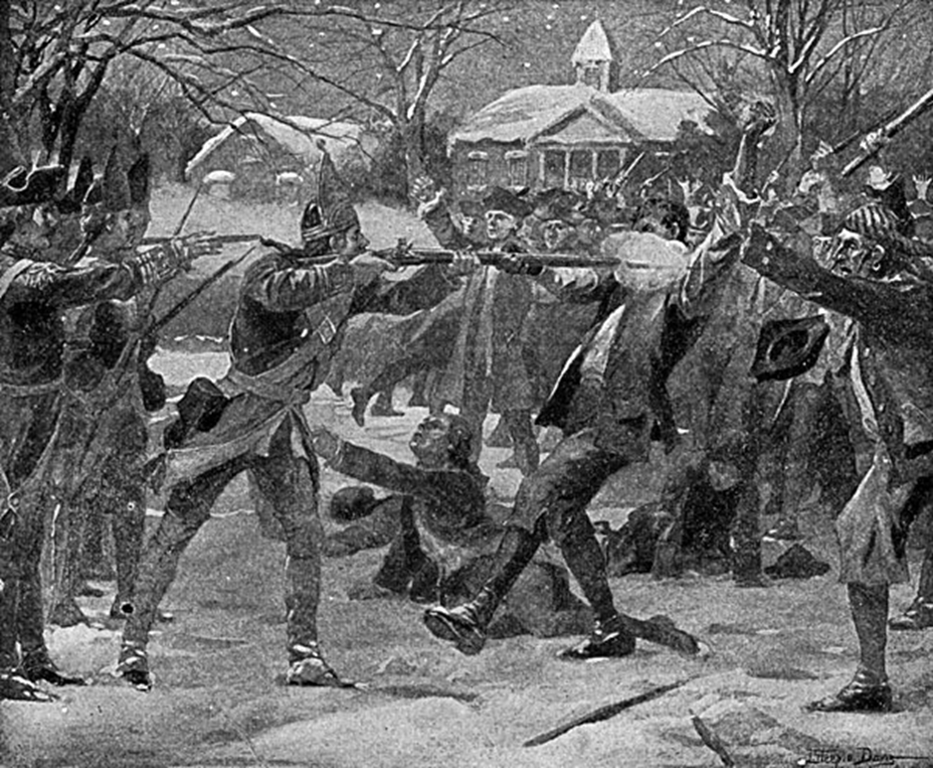

Slide 4
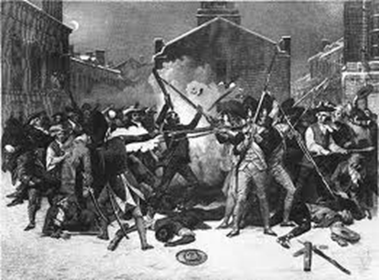

Slide 5
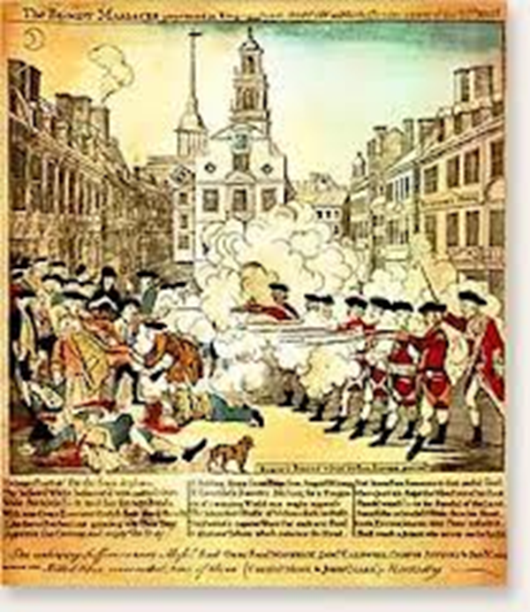

Slide 6
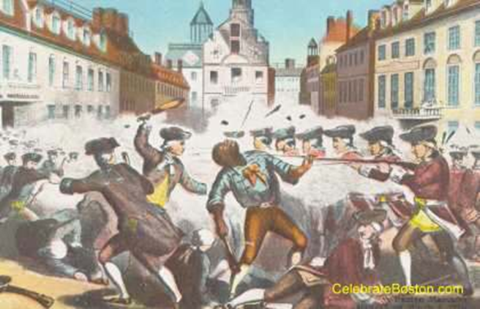

Slide 7
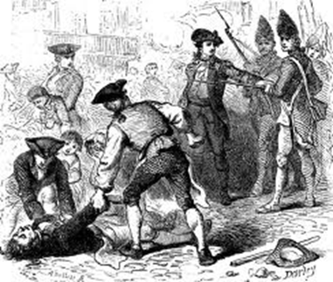

Slide 8
